Slide 1
FPGA Hero
Team Axx
Zeynep Ece Kizilates | Arman Tan | Sophia Delia | Shaun Ghosh

Slide 2
Motivation
Goal:
Create a game, similar to Guitar Hero, that can be played using a keyboard, speaker, VGA display, and FPGA
Developing this game requires extensive knowledge of Verilog, as well as the ability to synthesize code that works with multiple external gameplay components
Notes:
Sophia: The team was inspired by Professor Densmore’s discussion of old video games, and wanted to use the skills learned in class to make a game of our own. Our labs didn’t include using the speaker output on the FPGA, so we thought that adding sound functionality would be a good “new” challenge. To build on what we learned in lab one, we also wanted to add moving and color changing graphics.Essentially, we wanted to demonstrate what we’d learned throughout the semester, while learning skills that we wouldn’t have gotten to otherwise.

Slide 3
Specifications and Requirements
Hardware:
Output music to speaker
Register keyboard input during gameplay
Display moving tiles, background, and menus via VGA
Gameplay:
Add or subtract points depending on input
Move tiles
Generate appropriate notes at appropriate speed
Stop music if a note is missed
Notes:
Sophia: Hardware requirements include PWM signals that output different notes to the speakers, keyboard inputs that are successfully registered by the FPGA, and a VGA display with moving tiles, a background with columns for the different tiles, and menus that are all output by the VGA.
Gameplay- aka “software”- depends on reliable point tallying, tiles that move and change color smoothly and consistently, and notes that generate at the appropriate pitch and speed. Just as well, the music should stop if a note is missed

Slide 4
Functionality
VGA Display shows
Menu
Score
Falling tiles in four colors
Speaker plays a song when game mode and difficulty level is selected
Song speed changes for different difficulty levels
Song stops when it is a miss and restarts when it is a hit
Keyboard is used to
Make selections in the menu
Switch between menu-game-end screens
Hit tile when it enters the target zone
Notes:
Ece:The game has a start menu, an end of game menu, and a gameplay screen that all rely on the VGA and a state machine. Player actions are input with a keyboard connected to the VGA, and the speaker plays a song that depends on game mode and difficulty. Similar to Guitar Hero, each button corresponds to a tile, and points are scored when a title is hit in the correct zone.

Slide 5
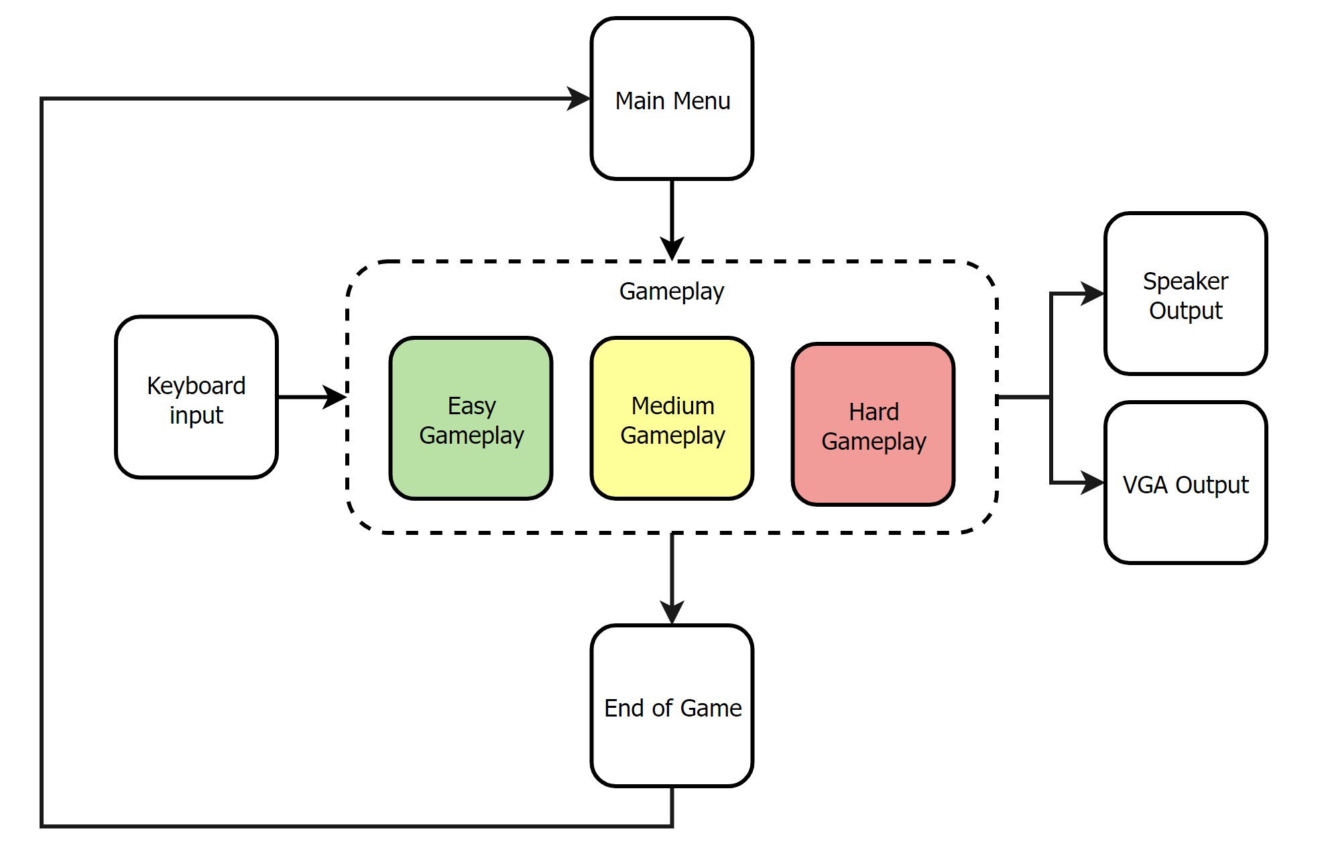
High level diagram
Notes:
Ece:Here we have a high level diagram. The different gameplay screens move sequentially and loop. Our method of input is a PS2 keyboard, and our outputs are speaker and VGA signals.

Slide 6
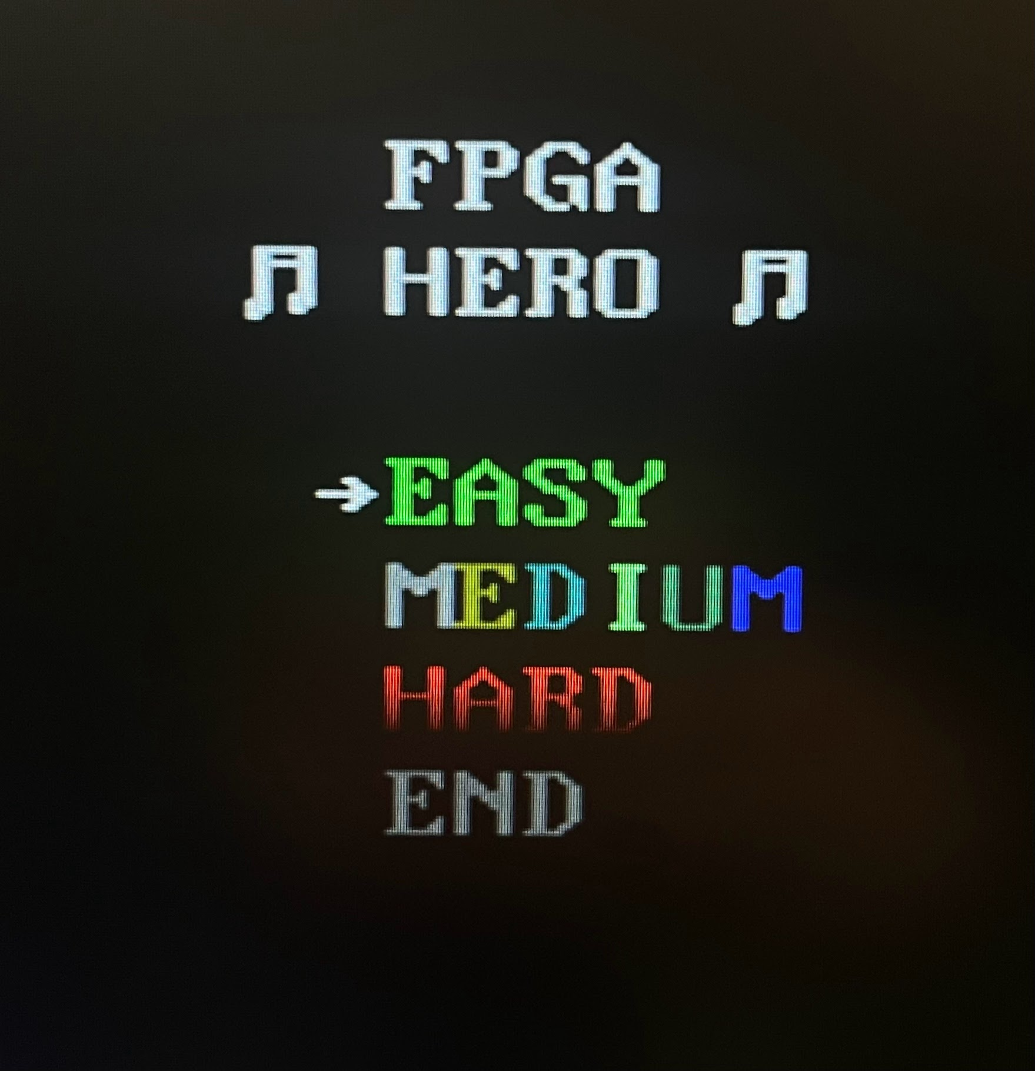
Main Menu
Scrolling using the keyboard
Selecting the difficulty level
Going directly to the scoreboard
Notes:
Ece:Here we have a high level diagram. The different gameplay screens move sequentially and loop. Our method of input is a PS2 keyboard, and our outputs are speaker and VGA signals.

Slide 7
Difficulty Levels
Slow falling tiles
Slow music
No point deduction when a tile is missed
Less points are gained when a tile is hit
Fast falling tiles
Fast music
Player loses points if a tile is missed or skipped
Double points are gained when a tile is hit
Glitches in tiles
Fast falling tiles
Fast music
Player loses points if a tile is missed or skipped
Double points are gained when a tile is hit
Notes:
Ece:Here’s a quick description of the different difficulty levels:
Easy gameplay has slow tiles and music, and doesn’t subtract points when a tile is missed, but you also don’t get as many points for hitting a tile
Medium has fast tiles, fast music, and deducts points. You gain double points when you hit a note.
Hard gameplay is the most complicated- the tiles “glitch” by flashing and changing color, the music is fast, and you lose points for missed or hit tiles. Like the medium gameplay, you get double points for successfully hitting a tile.

Slide 8
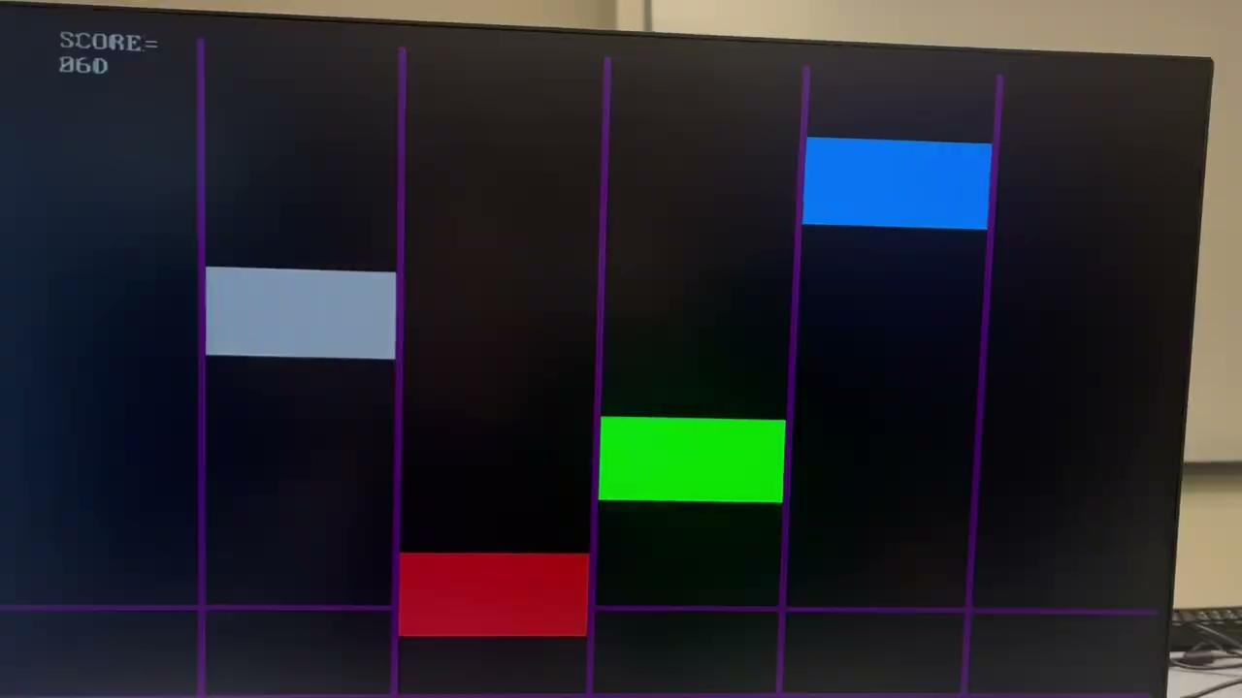
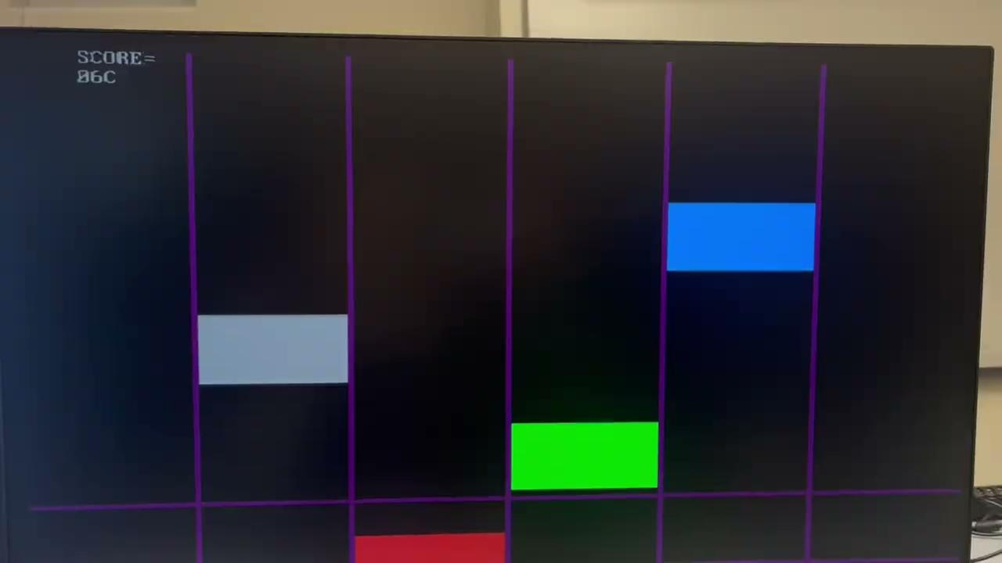
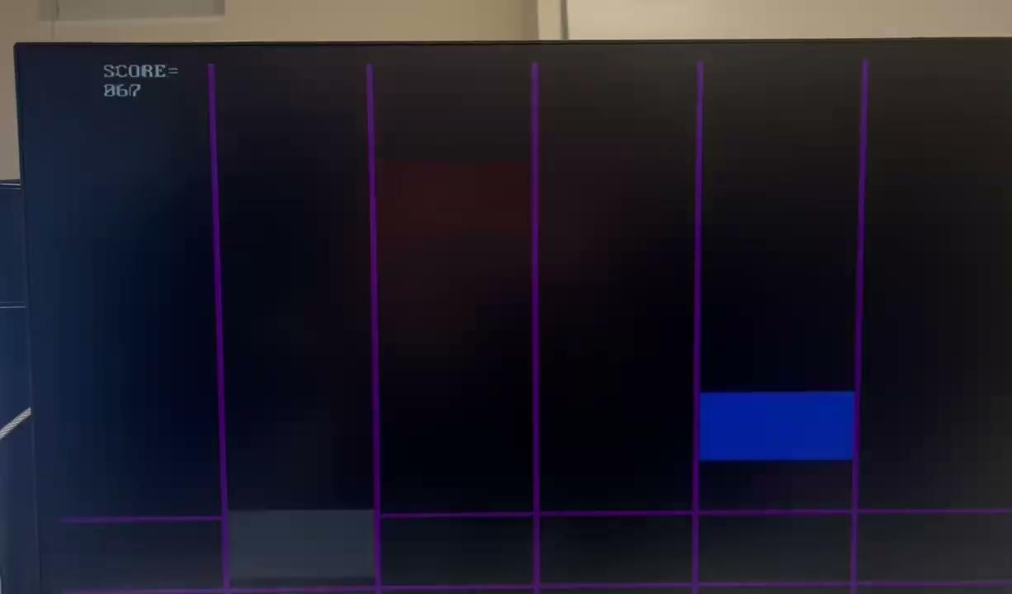
Difficulty Levels
Notes:
Ece:Here’s a quick description of the different difficulty levels:
Easy gameplay has slow tiles and music, and doesn’t subtract points when a tile is missed, but you also don’t get as many points for hitting a tile
Medium has fast tiles, fast music, and deducts points. You gain double points when you hit a note.
Hard gameplay is the most complicated- the tiles “glitch” by flashing and changing color, the music is fast, and you lose points for missed or hit tiles. Like the medium gameplay, you get double points for successfully hitting a tile.

Slide 9
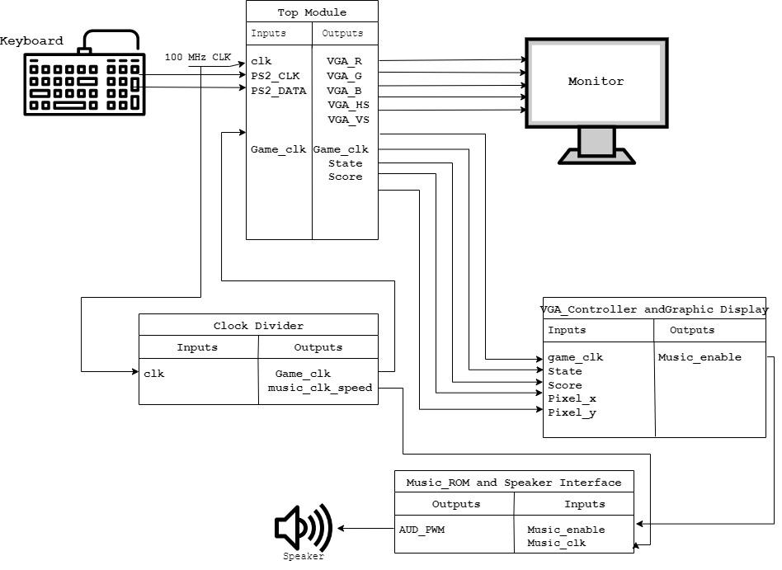
Additional Block Diagrams
Notes:
Ece: Here’s a more detailed block diagram of our top module, which shows the inputs and outputs required by each module and accessory hardware component.

Slide 10
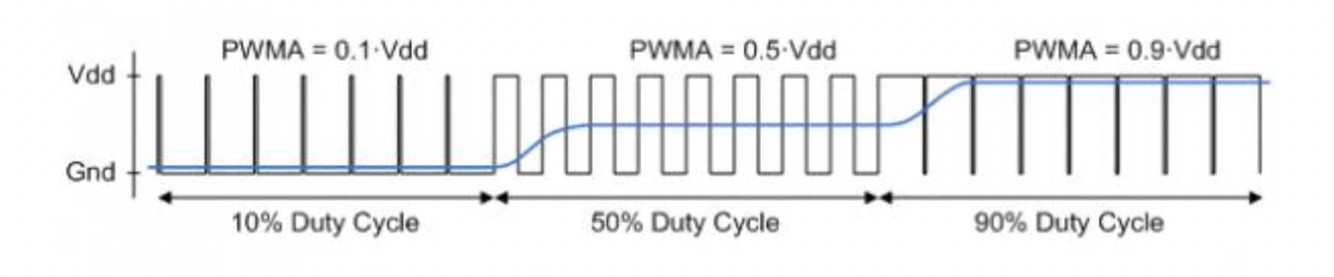
Detailed Functionality : Notes & Music
Each note is generated by dividing the input oscillator clock frequency by a certain value.
Counters increment through a range of values that correspond to each note value giving us various counts at which the signal is toggled.
Information about the notes of a song are stored in the ROM in a separate Verilog script.
The value of the note that is to be played for the song is taken from the ROM and based on that the duty cycle of the clock signal is altered before being fed into the speaker.
Output voltage generated by integrating the pulse train [Nexys A7 Manual]
Notes:
Shaun
Each note is generated by dividing the input oscillator clock frequency by a certain number. This is achieved by altering the time at which the signal is toggling from high to low or vice versa. Counters decrement from certain values selected by the note to zero.
Information about the song is stored in the ROM in the form of a verilog script.
Each note to be played is taken from the ROM, and based on that the duty cycle of the clock signal is altered before being fed into the speaker.

Slide 11
Detailed functionality: Speaker
Sound on Nexys 7 board is generated by taking the oscillator clock and dividing it into various different frequencies and passing it to the low pass filter which acts as a reconstruction filter to convert the digital input into an analog audio jack output.
The input of the filter (AUD_PWM) is connected to the FPGA pin A11.
A digital input is either a pulse-width modulated (PWM) or pulse density modulated (PDM) open-drain signal produced by the FPGA.
Notes:
Shaun
The on-board audio jack is driven by a Sallen-Key Butterworth Low-pass 4th Order Filter that provides monoaudio output. A digital input will typically be a pulse-width modulated (PWM) or pulse density modulated (PDM) open-drain signal produced by the FPGA. The signal needs to be driven low for logic ‘0’ and left
in high-impedance for logic ‘1’. An on-board pull-up resistor to a clean analog 3.3V rail establishes the proper voltage for logic ‘1’. The low-pass filter on the input acts as a reconstruction filter to convert the pulse-width modulated digital signal into an analog voltage on the audio jack output.

Slide 12
Detailed Functionality: VGA
VGA Display Generation
Slowed clock signal for tiles; horizontal and vertical VGA counters are used to “draw” on screen.
Video enable flag determines whether area of screen should be drawn on or used as buffer.
Graphics Generation
VGA ROM
Each character is defined using a 2D array.
Hex address of character determines character displayed.
If a bit in the character array is high, its RGB values are output via VGA.
Falling Tiles
Each tile is defined using a greater-than or less-than statement.
Characteristics of each tile depend on their onscreen location.
Colors change depending on gameplay mode.
Notes:
Arman: The VGA is one of the most complex parts of the project. First, a base VGA module generates the appropriate signals needed to “draw” on the screen, including vertical and horizontal syncs (blank parts of the screen where signals can “catch up”) and x and y positions used for drawing graphics.
The VGA ROM is an array of ascii characters used for any words or numbers displayed on the screen. This includes menu options and scores
The falling tiles are defined in a graphics module separate from the ROM, which outputs different RGB signals depending on the difficulty level.

Slide 13
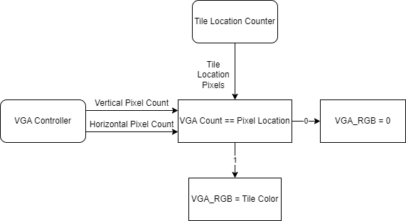

Detailed Functionality: VGA
Tile Display and Movement with VGA
For the line displays pixel locations are pre-defined.
For the display of the ASCII characters, pixel locations are used from the ASCII-ROM.
For the flashing tiles, RGB output is given as the last 4-bit of the vertical-pixel count.
Notes:
Arman

Slide 14
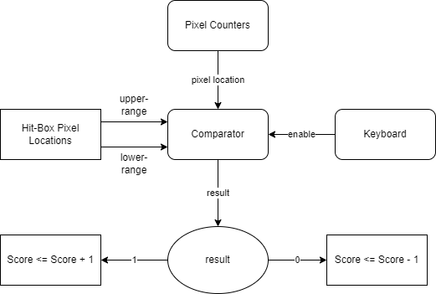
Detailed Functionality: Score System
Hit or Miss System for Scoring
The comparison is enabled by the positive edge of the done signal of the keyboard.
Amount of score change depends on the difficulty of the gameplay.
Hit or Miss system also enables or disables the music.
Notes:
Arman: The score of the game updates every time a key is pressed on the keyboard or a tile is reached the bottom of the screen. The score evaluation process when the a key is pressed on keyboard is done in this slide.

Slide 15
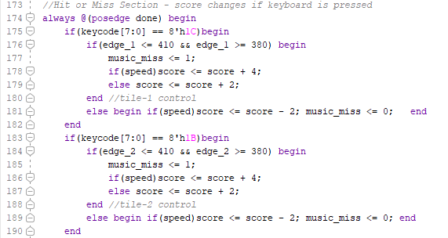
Clear Verilog Example
Verilog Code for hit or miss when keyboard is pressed
Keycode and done signals are coming from the keyboard
Music_miss enables or disables the music play
Score increase is changes depending on the difficulty
Score is reduced when tile is missed
if it isn’t easy game mode
Notes:
Arman: The verilog code for the hit or miss detection when a key is pressed is given in this slide. The main trigger for this process is the done signal coming from the keyboard.

Slide 16
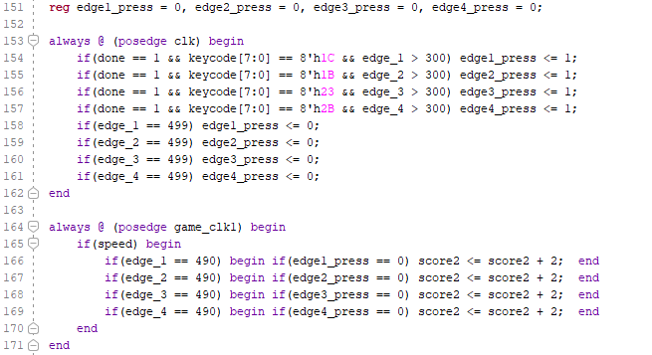
Clear Verilog Example
Verilog Code for losing point in the case for skipped note
Key-press registers keeps track if the player presses the button while tile falling.
The deducted score increases if the key is not pressed yet when tile reaches end of the screen.
assign score_overall = score - score2;
Notes:
Arman: The verilog code for the detection of if a tile is skipped or not is given in this slide. The main trigger for this process is a tile reaching a certain vertical pixel count. For the edge_press registers the 100MHz clock is used in order to both detect the done signal from the keyboard but also reset the edge_press register when a tile reaches to the end.

Slide 17
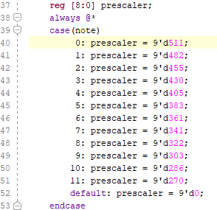
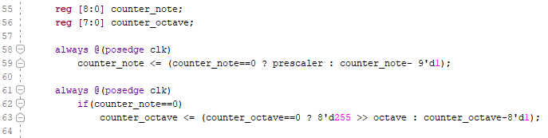
Clear Verilog Example
Verilog Code dividing clock frequency
Prescaler has values from 0 to 512,
Each range of values represents a note. Going from one note to next requires frequency to be multiplied by ~1.06.
Counters, note and octave that count down from the value selected and invert the output at 0
Notes:
Shaun: Part of the verilog code for the dividing the clock frequency is given in this slide. The process starts when the note and the octave is received from the verilog script that takes the full note value from the rom and splits into the octave and the note that is to be played. Once they are received, the note value selects a particular prescaler value which is assigned to the counter_note binary counter that counts down from the prescaler value to zero before inverting the output to the speaker. The sound produced by the speaker is dependent on how long the prescaler value takes to count down to zero, before toggling the output signal i.e. it changes the duty cycle of the clock.

Slide 18
Successes
Basic Sprite Implementation - Arman
Sprite: a 2D map of pixels used to create game graphics
VGA ROM implementation uses bitmaps to display characters
Keyboard Implementation - Arman, Ece
FPGA successfully captures keyboard input (or lack thereof), adjusts score accordingly
Game Structure - Arman, Ece
Game successfully cycles through menu, gameplay, and end menu states
Sound Generation - Shaun, Ece
Verilog code uses a clock divider to generate different note frequencies
Different frequencies are coded in order to make a song
If a note is missed, the music stops
Notes:
Sophia: Ultimately, the team met the requirements for their minimum viable product. The game has a structure, defined by a state machine, which includes different menus and gameplay levels. The keyboard can be used to hit tiles, and the sound generation was a success- using PWM to generate different notes allowed for songs to be customizable. At the end of the day, the game is clean, consistent, and fun to play!

Slide 19
Failures
Advanced Sprite Implementation - Sophia
Advanced Sprites: sprite graphics with detail similar to that of 8-bit games
Approaches we tried:
Making a shape in a two-bit, two-dimensional array, then defining the colors of the sprite based on bit quantity (0 or 1)
Making a shape in a two-dimensional array, storing that shape in a ROM, then populating the shape with conditional statements that altered VGA RGB output
This worked with the pre-defined text ROM, but not ROMs that Sophia defined
Using the Vivado Block RAM IP, generating a ROM from a .coe file, and feeding the IP output to the VGA output
Cause of failure:
VGA output always stayed low
Simulations showed that vertical and horizontal counts did not iterate, so VGA output was never generated
Design Tradeoff: to be able to implement sound in time, advanced sprite implementation was not completed
Notes:
Sophia: Originally, I wanted to do graphics similar to those of 8-bit video games, or the balloon shooter game that we saw demoed in class. I tried a few different sprite implementations, but couldn’t get the graphics to work. This was a design tradeoff that I’m not thrilled about- even though I started doing the graphics early, toward the end of the development process the team had to choose between putting all hands on deck to implement sound, or continuing to work on graphics. While I didn’t get the sprites to work as I would have liked, I did learn about using bitmaps, the different signals necessary for VGA implementation, and using block RAM/Vivado IPs to generate VGA graphics.

Slide 20
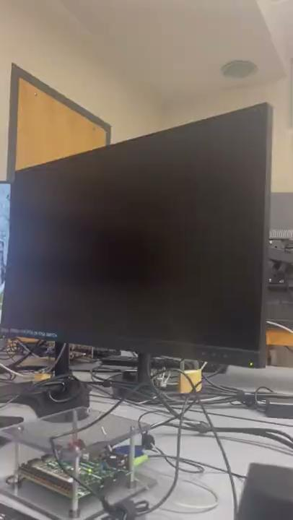
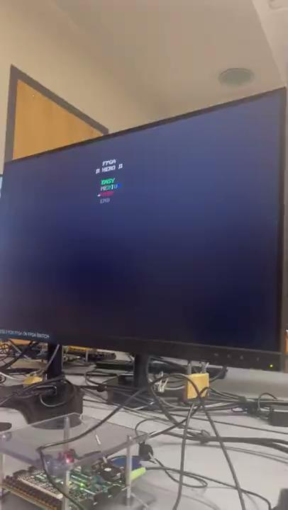
Videos

Slide 21
References
Sprite Generation
Lab 1 Sprite Code
https://projectf.io/posts/hardware-sprites/
http://ca.olin.edu/2005/fpga_sprites/results.htm
https://web.mit.edu/6.111/volume2/www/f2019/handouts/labs/lab3_19/index.html
Sound Generation
https://www.fpgakey.com/tutorial/section570
https://www.fpga4fun.com/
Miscellaneous
https://github.com/buraksibirlioglu/FPGA-Guitar-Hero
https://github.com/vinamarora8/FPGA-PS2-Interface/blob/master/keyboard.v
Nexys A7 FPGA Board Reference Manual
Notes:
Sophia: We read a lot of material to pull the game together. Here are our sources.

Slide 22
Thanks for Watching!
Questions?
Notes:
Thanks for watching!

